Slide 1
Object to Story
Jimmy Johnson, Ignacio Marroquin, Gerardo Rodriguez

Slide 2
Goal
Combine a classifier with an RNN for text generation.
Create a GUI for deployment.

Slide 3
Motivation
Explore methods of entity representation
Generating more realistic stories
Notes:
Entity representation, using an object and referring to it in other ways.
Ex: Air bud jumped in the air. He fell on a ball.

Slide 4
Methodology
Utilize a pre-trained classifier (ResNet or VGG)
Train a RNN with large amounts of text data.
Use datasets containing data from one author.
Combine the two
Feed results of classifier to the RNN
Generate Story based on the input object
Add a voice module for reading story output and voice commands
Notes:
We will take the main part of our project and divide it into two. The first step is to train a classifier on ImageNet. Next we will train an RNN on several datasets, we will also try and focus on generalizing the network to focus on the object that is given as an input.
Once they are both trained we can use the classifier to return an object to feed into the RNN text generator. This output can then be read aloud using a voice module.

Slide 5
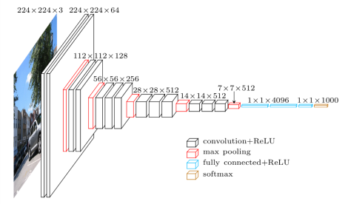
ResNet and VGG
https://www.cs.toronto.edu/~frossard/post/vgg16/
Notes:
Just the two networks we are considering on using.

Slide 6
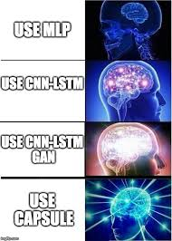
LSTM
Using the LSTM RNN
Long short term memory.
Use GRU Cells

Slide 7
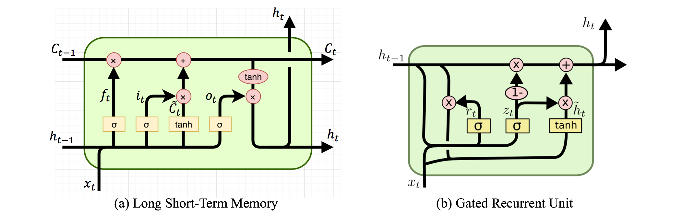
GRU vs LSTM

Slide 8
The datasets
Classifier
ImageNet
RNN
Kaggle classical literature
Notes:
Image Net lets you download large amounts of images, either on the website or downloading the url files for the classes.
Kaggle
Kaggle has large amounts of datasets and finding text data is easier here. For example they have seinfeld scripts, fraiser scripts, and the scripts for star wars.

Slide 9
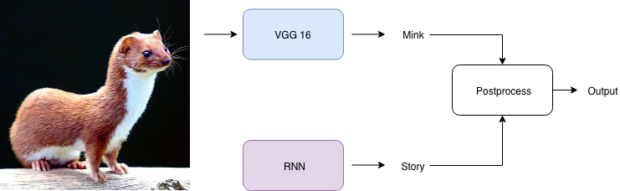
Combined flow
Notes:
We use NLTK to serve as our natural language processor

Slide 10
Demo

Slide 11
References
Classifier references:
ResNet https://arxiv.org/pdf/1512.03385.pdf
VGG https://arxiv.org/pdf/1409.1556.pdf
RNN references:
https://github.com/martin-gorner/tensorflow-rnn-shakespeare
https://www.tensorflow.org/tutorials/sequences/recurrent
http://www.aclweb.org/anthology/N18-1204 (Paper)
http://www.aaai.org/ocs/index.php/AAAI/AAAI17/paper/download/14571/14217 (Paper)
https://www.aclweb.org/anthology/D17-1195 (Paper)
Datasets:
http://image-net.org/
https://www.kaggle.com/mylesoneill/classic-literature-in-ascii
https://www.kaggle.com/rtatman/blog-authorship-corpus
https://www.kaggle.com/rtatman/natural-stories-corpus/home

